Slide 1
Notes on MFP reservoir model
July 2017

Slide 2
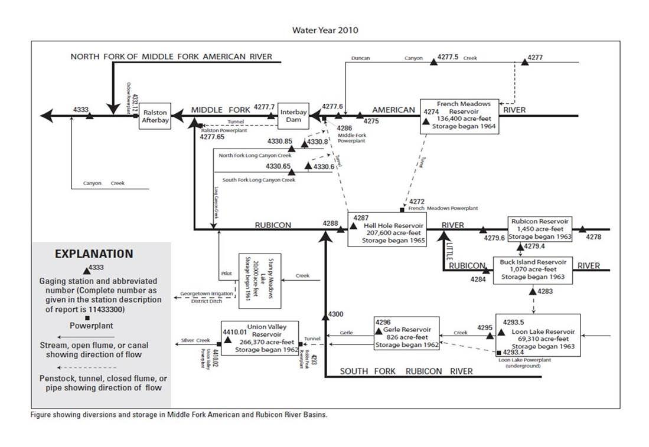

Slide 3
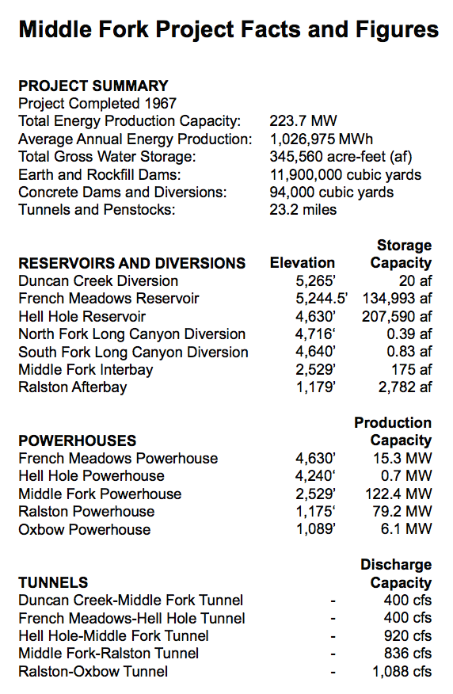
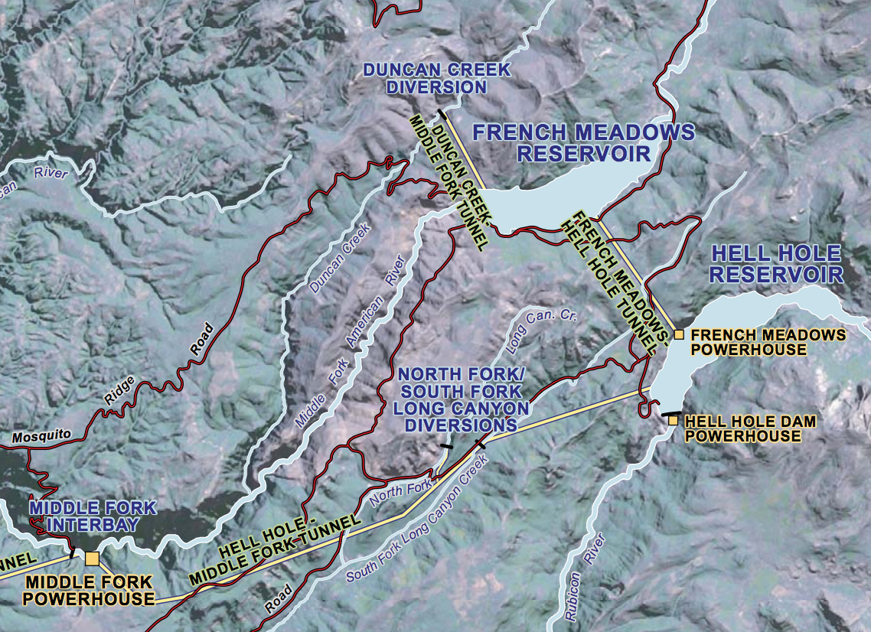
Simplified 2-reservoir model (source)

Slide 4
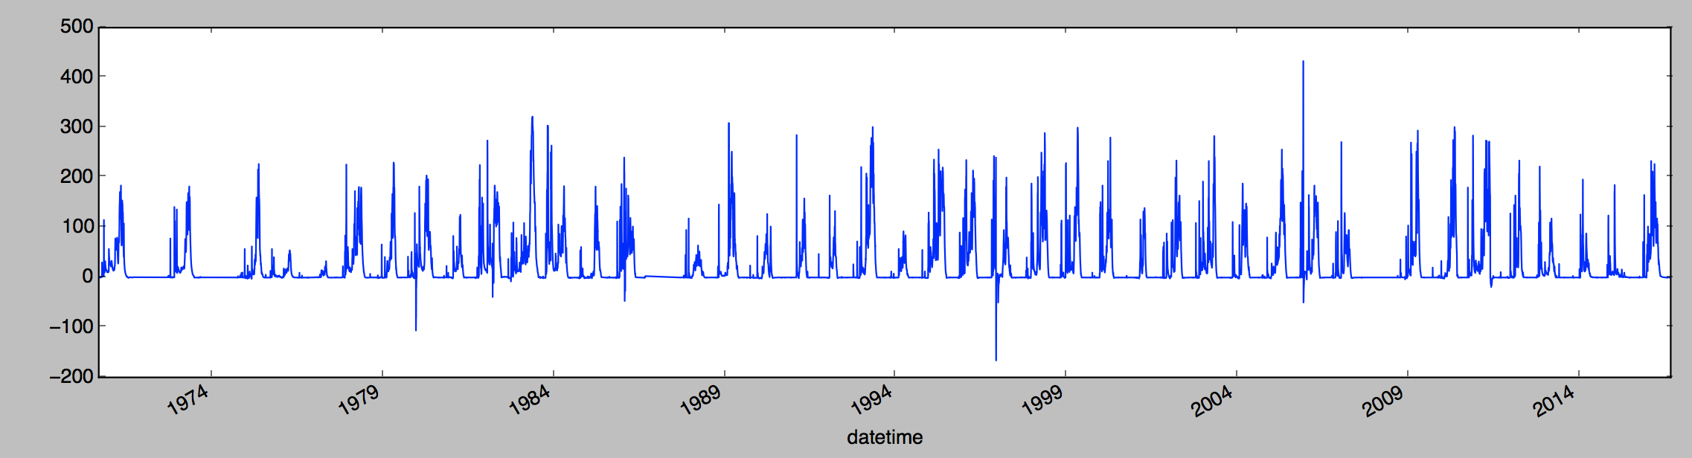

FMD inflow from Duncan Creek

Slide 5
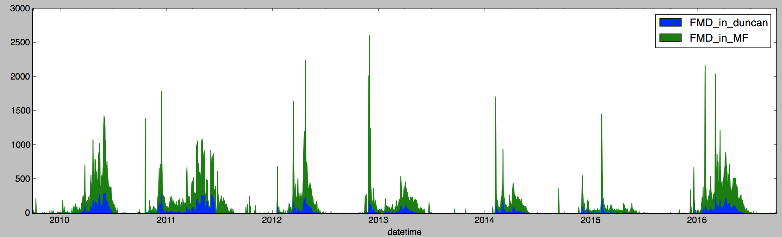
FMD inflow from MF American
Most of FMD is coming from here, but Duncan Creek is not negligible. Watch out for missing data periods.
Ignoring evaporation for now

Slide 6
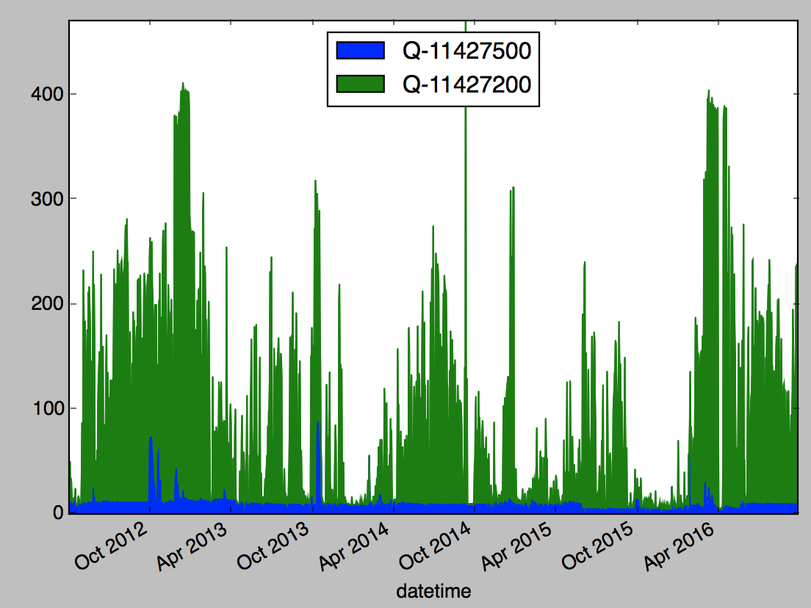
Releases from FMD
Green = French Meadows Powerplant. Blue = into American River

Slide 7
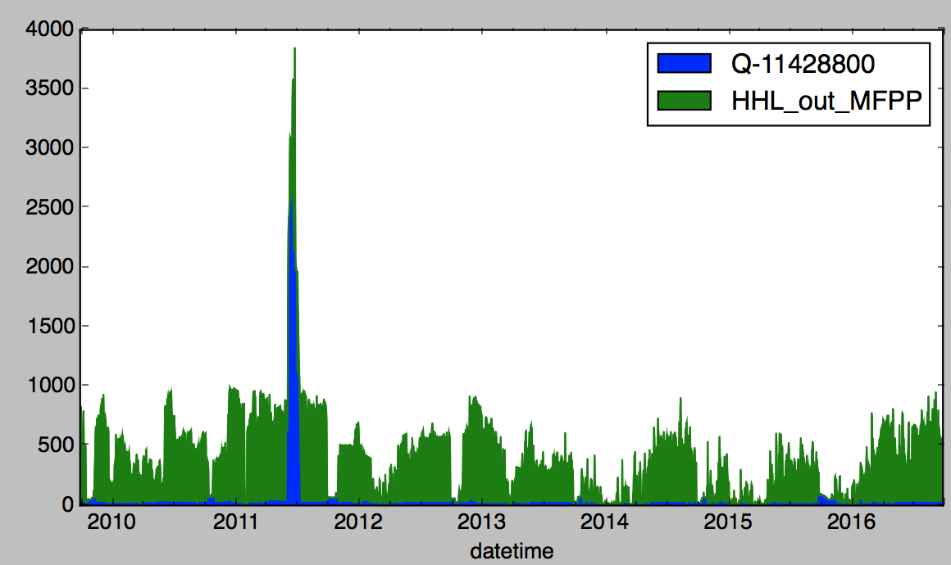
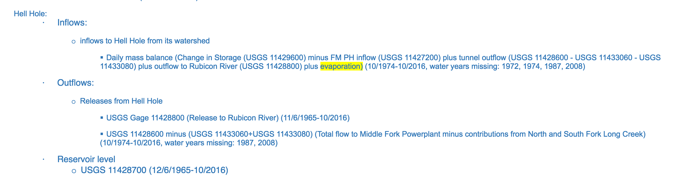
HHL Outflows

Slide 8
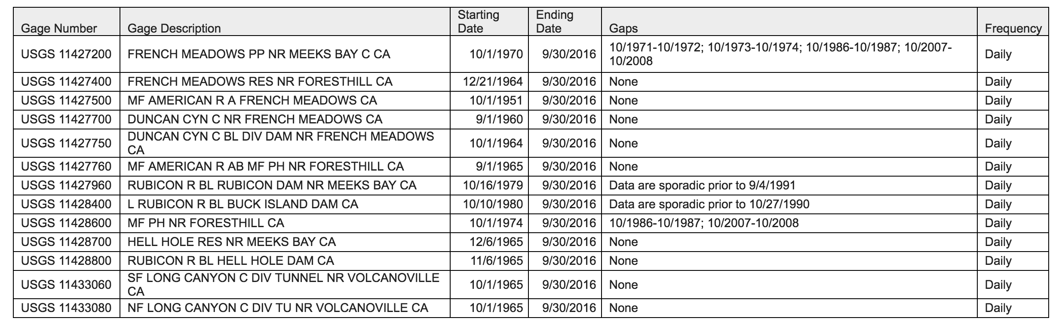
Missing data
Missing WY 2008 for two powerhouse flows
This would not matter, except these are needed to calculate both reservoir inflows
Once we have RHESSys inflows to FMD/HHL, then we can have as long of a model run as we want. But for the historical period we should start 10/1/2009.

Slide 9
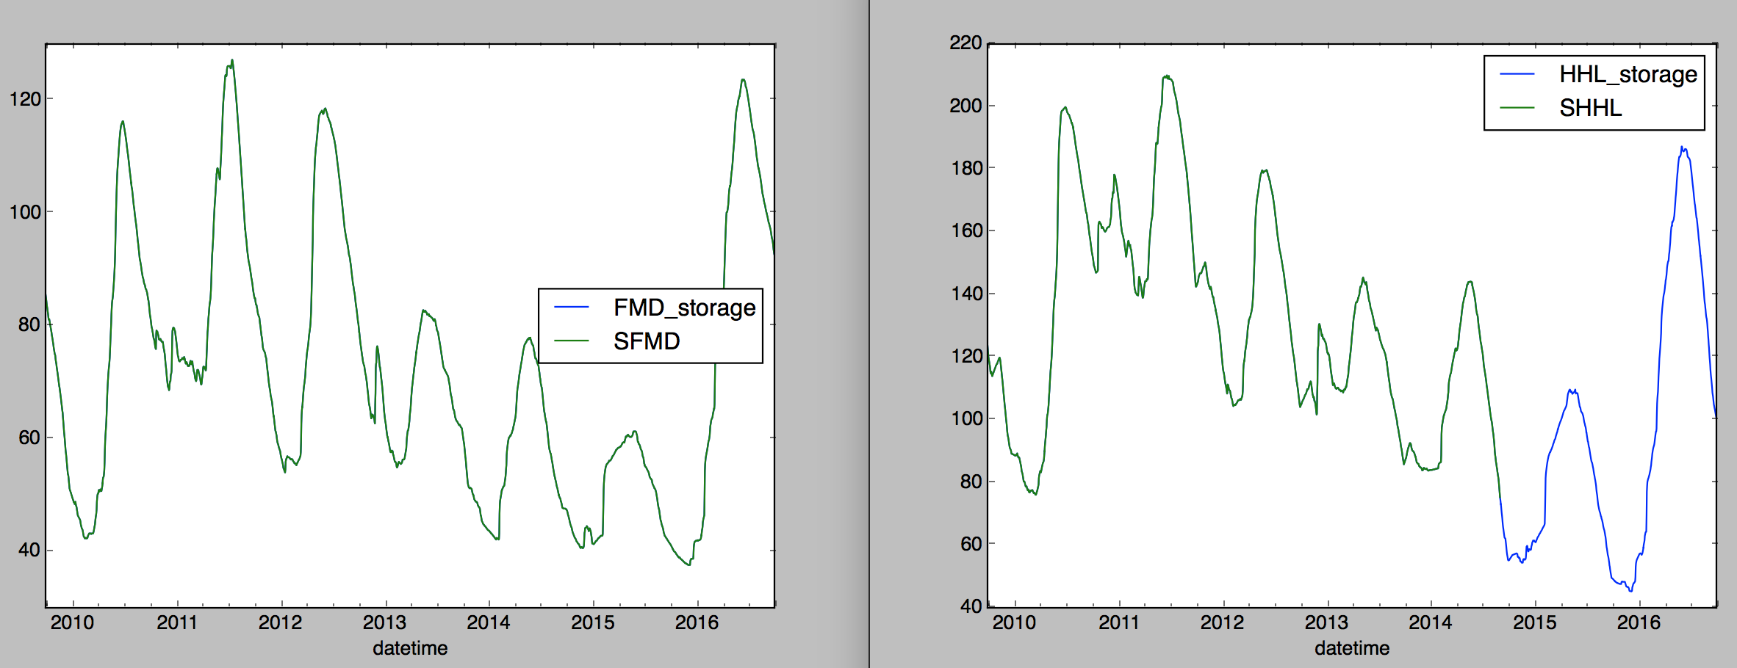
Matching mass balance (when cheating using USGS gages)

Slide 10
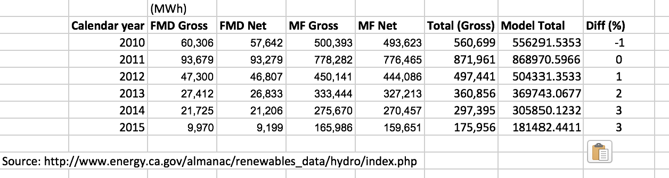
Check hydropower calculations w/USGS flows
Assumption: constant hydraulic head. Data from:
http://relicensing.pcwa.net/var/www/html/public_html/documents/Resource_Agencies_PMEs//USFS%20-%20August%205,%202011/04_Enclosure%20III/FS_lit%20cited_2/20110805-5082(26145358).pdf
Important: calibrated 80% efficiency to account for turbine losses and tunnel head losses
This is as good as it gets---but a concern is that the effect of the vegetation & ecosystem scenarios will be within this error

Slide 11
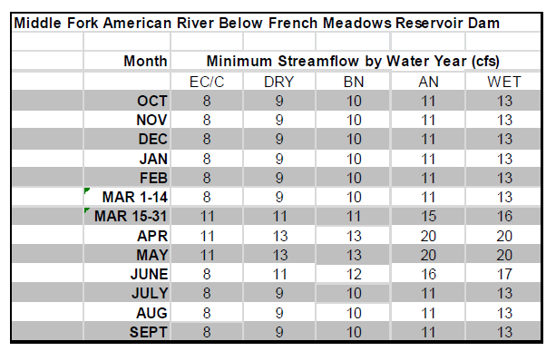
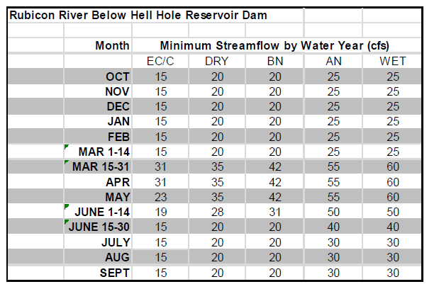
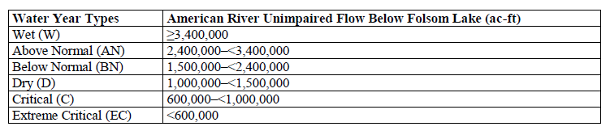
Environmental flows
First: year-round instream flow reqs. in the bypass regions (from Kristen) we are not changing these

Slide 12
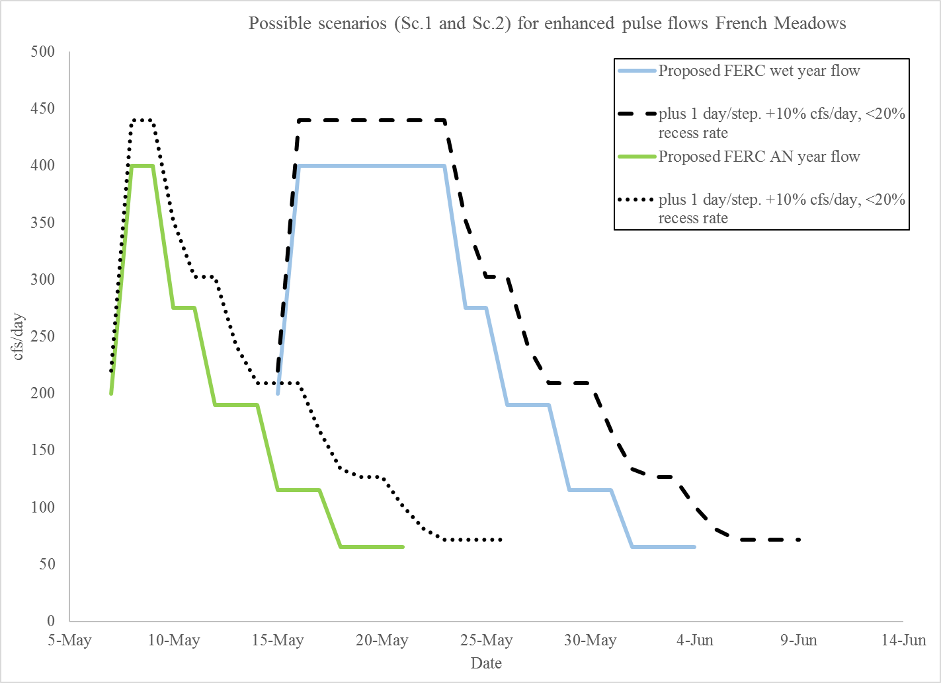
Environmental flows
Second, add pulse flows. 4 scenarios:
No pulse (only instream flows)
FERC proposed (“FERC”)
+1 day/step, +10% cfs/day (“increase”)
Same, plus a <20% restriction on rampdown (“increase_rampdown”)
** I added Wet-year pulse flows to all WYTs for maximum effect, but in Kristen’s writeup they are only applied in Wet and Above Normal years

Slide 13
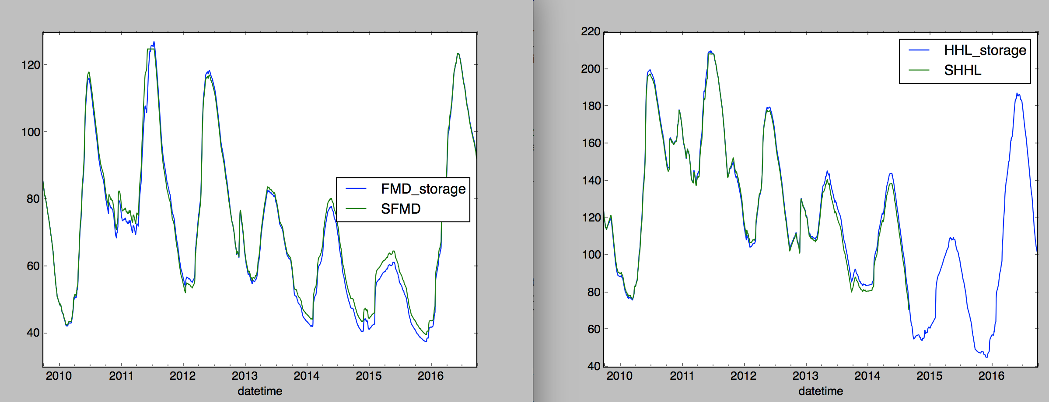
Mass balance using instream flows (no pulse)
Historically they may not have followed the new FERC rules exactly. This is pretty good. (Still using USGS observed hydropower releases)

Slide 14
Fit historical release policy
*Need this to test changes in other scenarios
Try to fit R^2 of storage or release timeseries?
Release is much harder to fit… in reality the operations of the two reservoirs are not perfectly correlated
Indicators: storage, day of year
Action: % of combined hydro release activated (0-1)
Objective: Fit R^2 (later, maximize combined power)
Fitting storage, can get R^2 ~ 0.91
Fitting release, only R^2 ~ 0.40 (more flashy)
Eventually switched to RMSE on storage instead

Slide 15
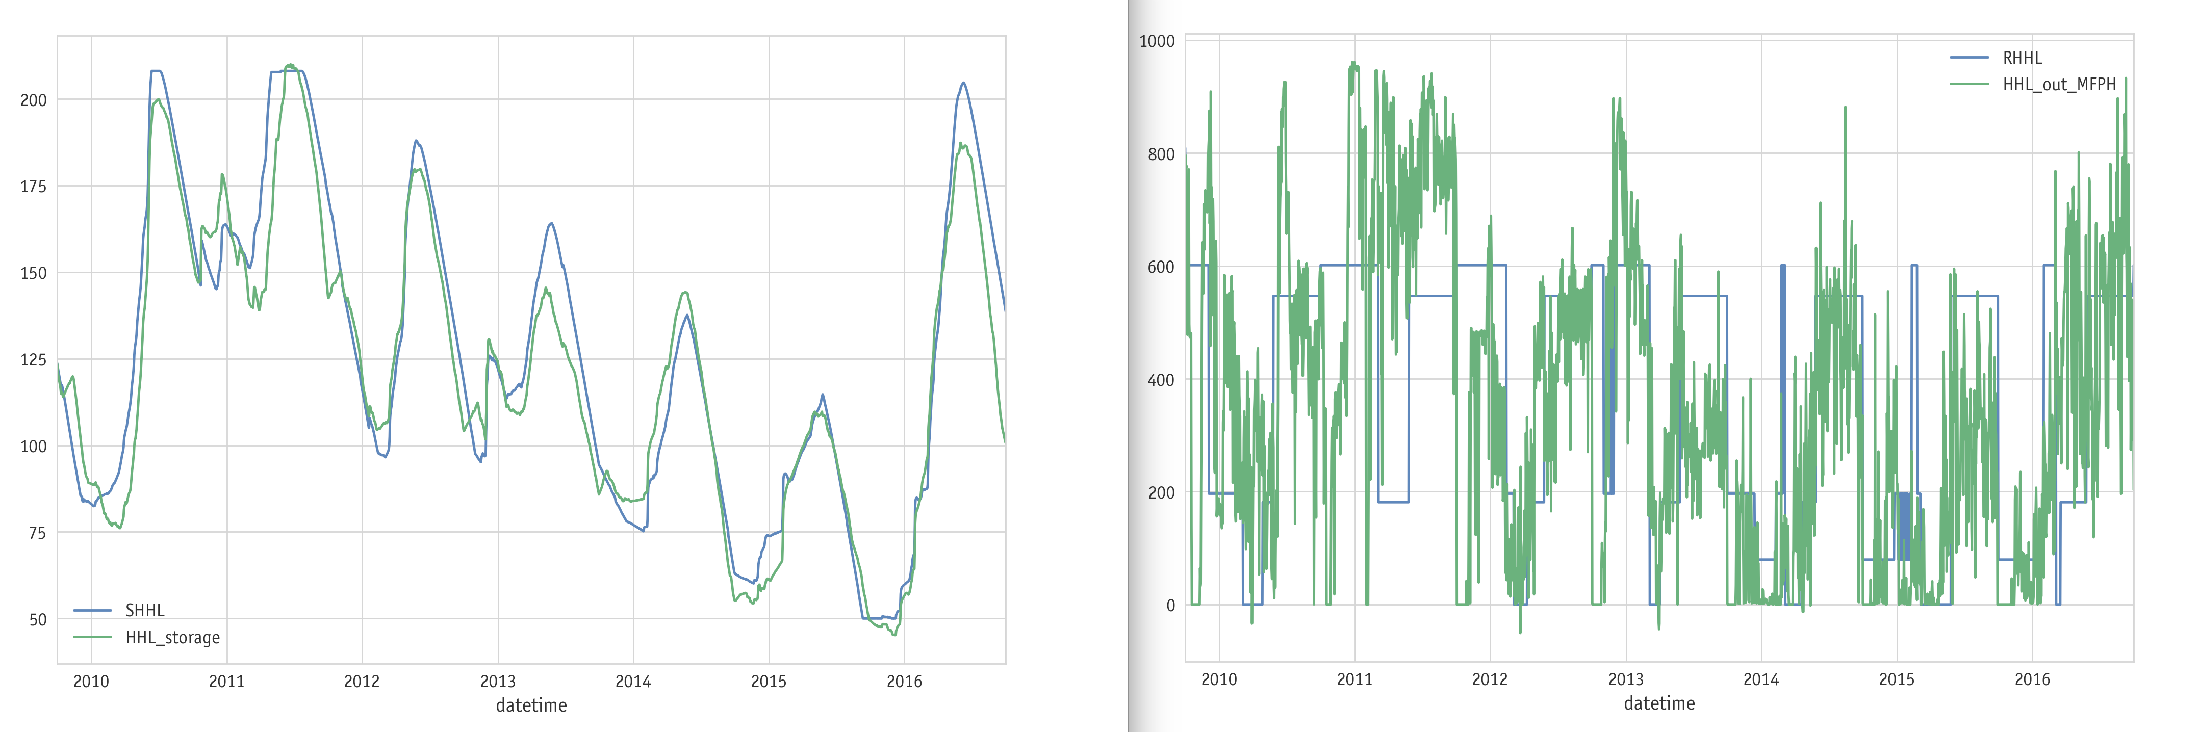
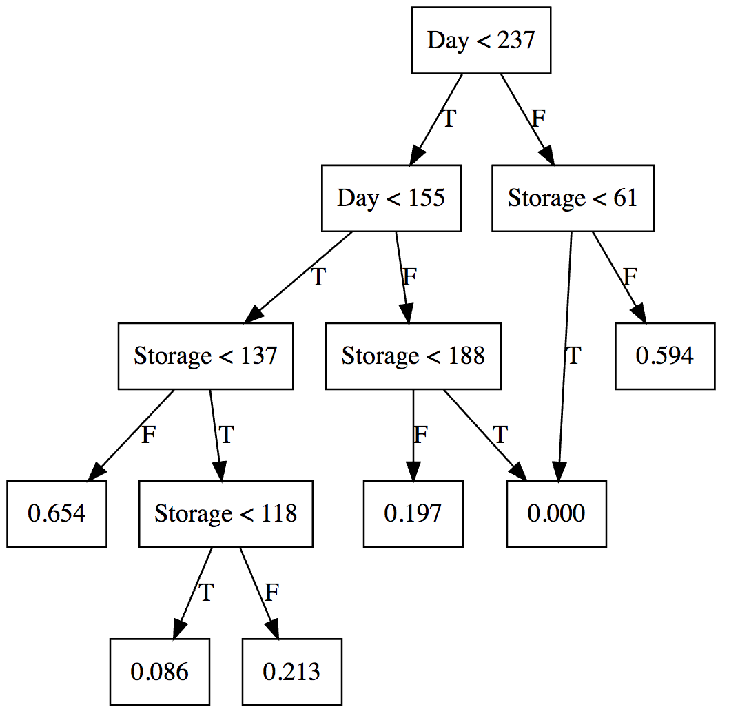
Fit: HHL
Storage (left) is much easier to fit than release (right)

Slide 16
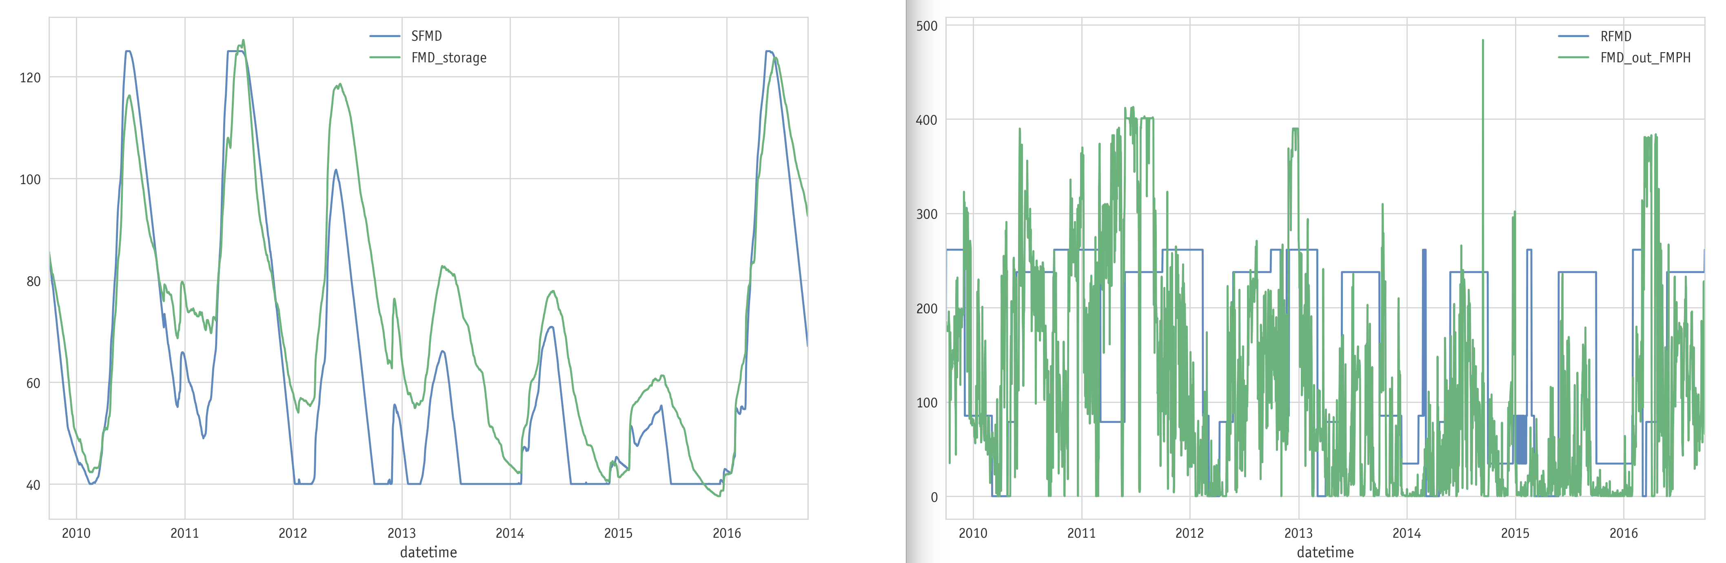
Fit: FMD
Not as good as HHL. But this was the policy that minimized RMSE (storage) after 25,000 function evaluations.

Slide 17
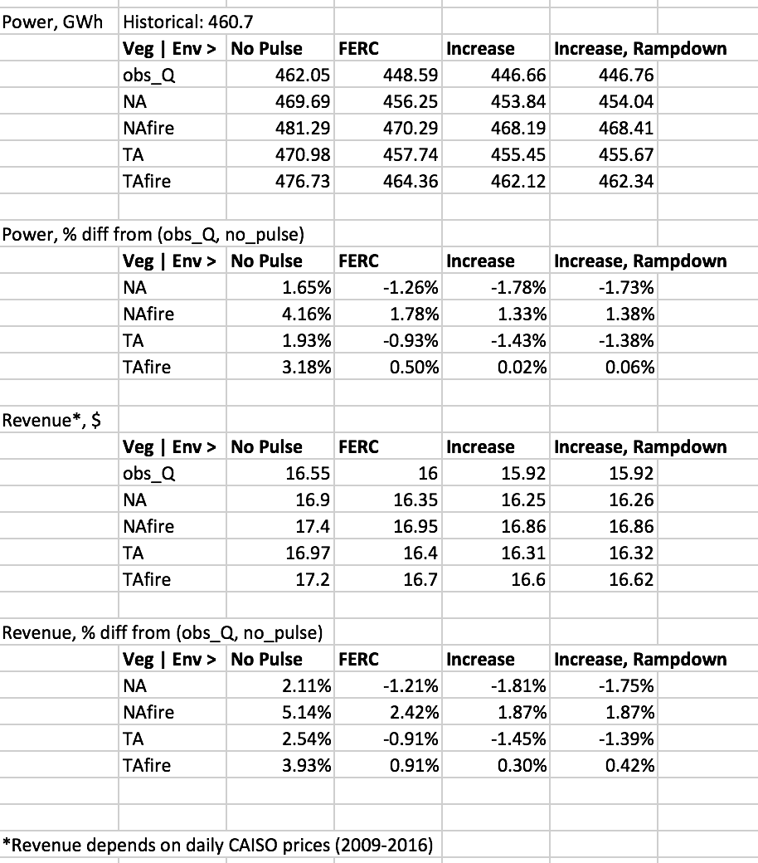
Results (simulate other scenarios with the best-fit policy)

Slide 18
Next step: reoptimize in each scenario
How do the benefits change if the release policy is revised to take into account the new hydrology and environmental requirements in each scenario?
This will take some computing time.

